Slide 1
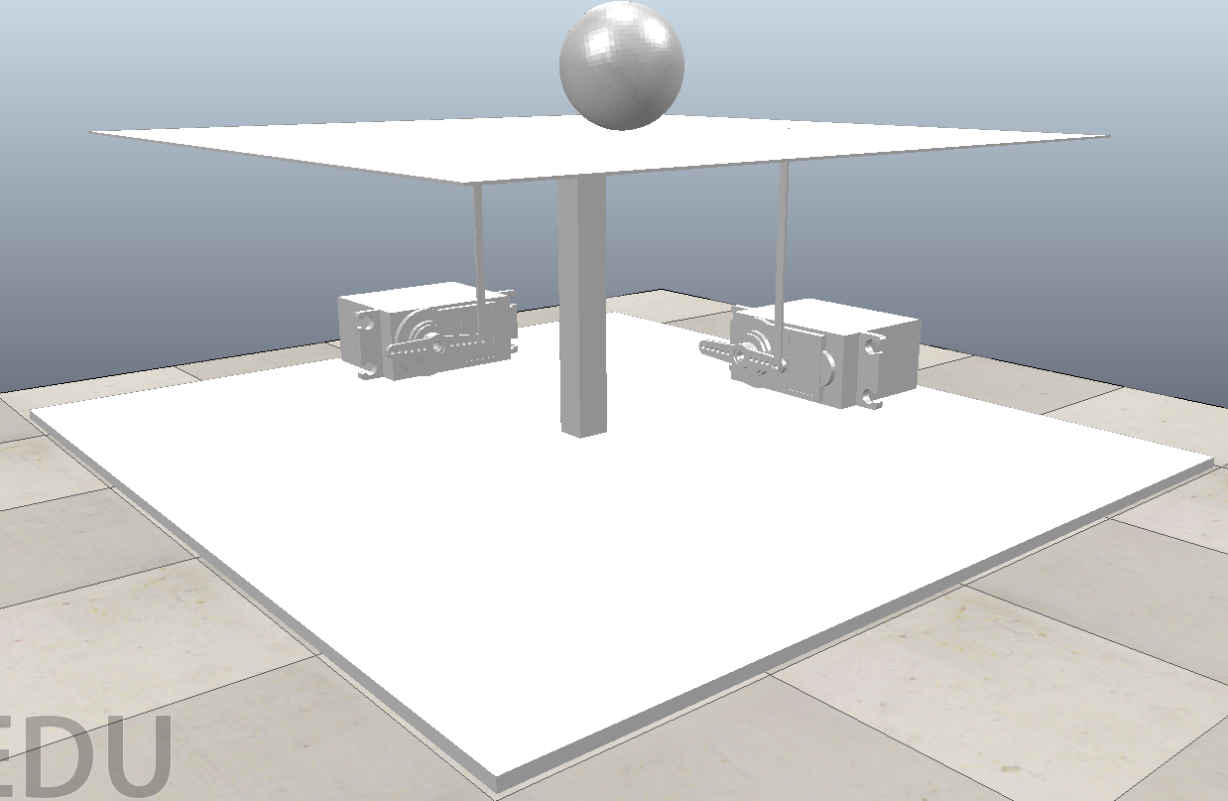
Ball and Plate
Group:
Nicholas Chenevey
Janette Calvillo Solis
Joseph Mount
Jason Fry
Jonathan Okonkwo
Notes:
Hello Dr. Bank,
Here is our Ball and Plate System presented by Nicholas Chenevey, Janette Calvillo Solis , Joseph Mount, Jason Fry and myself Jonathan Okonkwo.

Slide 2
Project Description
A controller for a ball and plate system was designed using Matlab, Simulink and Coppelia. The system had to keep a ball balanced at the center of the plate and must react according to the ball’s position to prevent the ball from falling off the plate.
Notes:
To briefly introduce our project, we made a controller for a ball and plate system. In order to do this we used our knowledge of Matlab, Simulink, and Coppelia. The main objective for this system was that the system had to be able to keep a ball balanced at the center of the plate and also had to react solely according to the position of the ball in order to prevent the ball from falling off the plate.
I will now pass it over to Janette and she will go more into depth on the design process of our system.

Slide 3
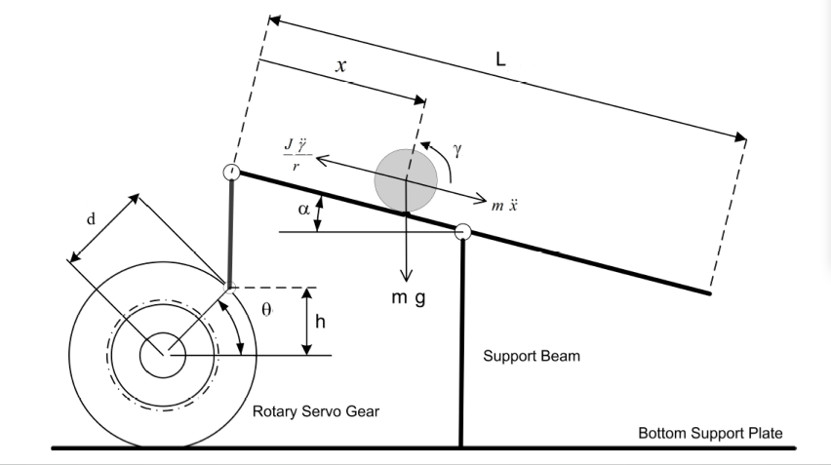
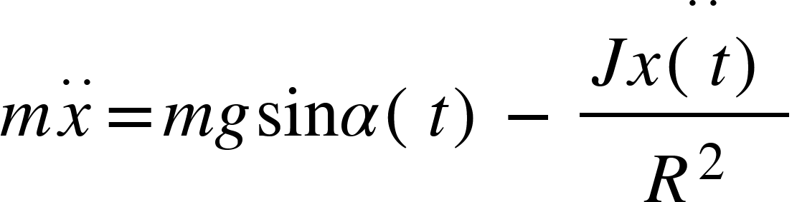
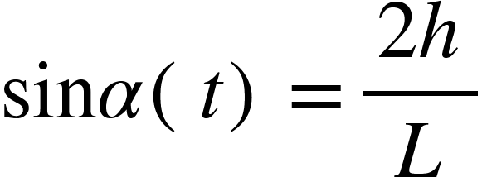
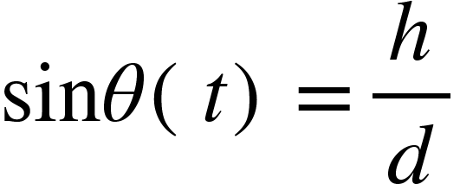
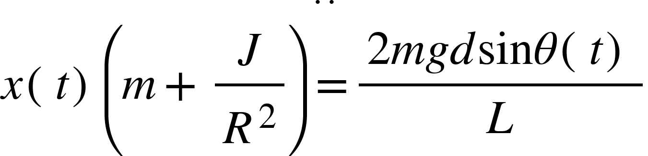
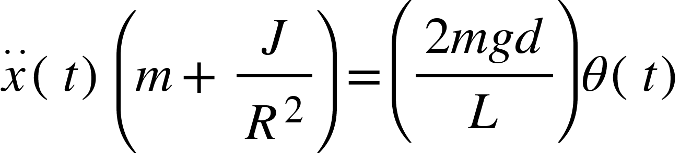
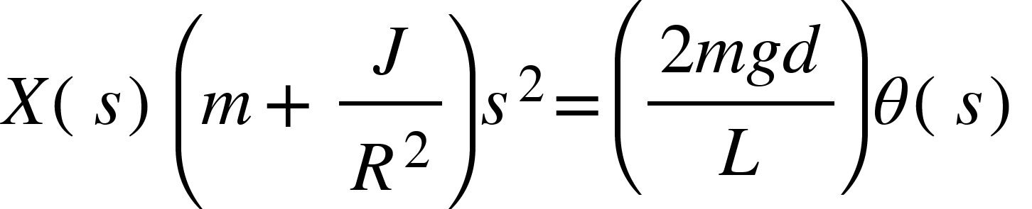
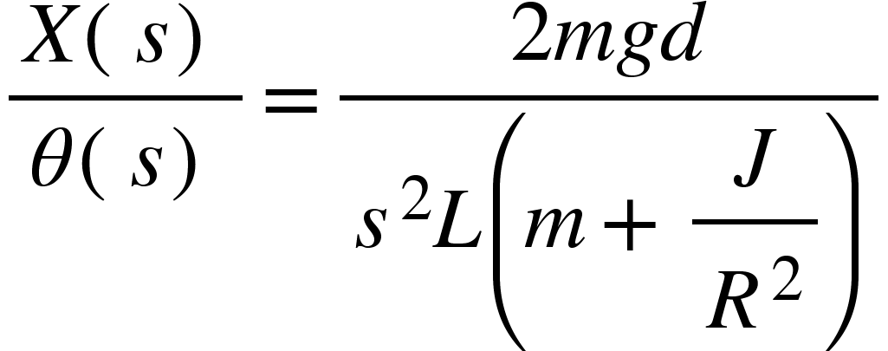
Modeling
Equations:
Eq 1
Eq 2 and 3
Eq 4
Eq 5
Eq 6
Eq 7

Slide 4
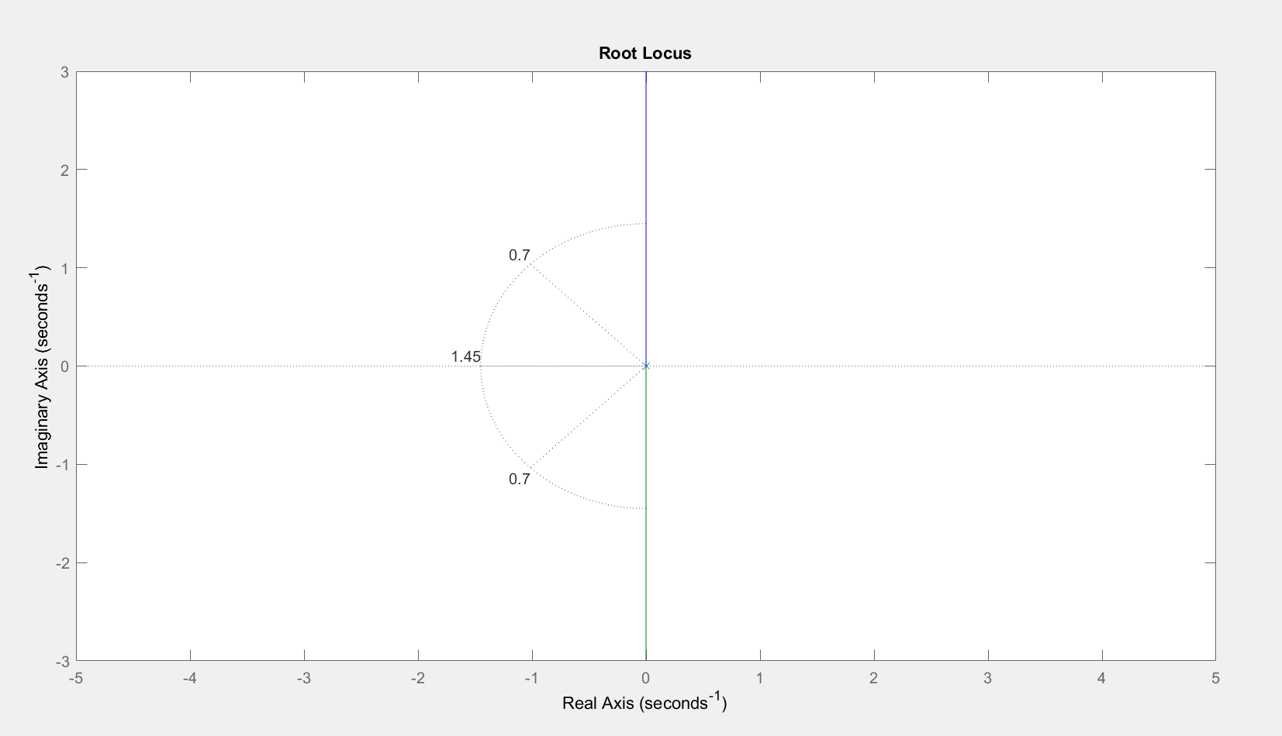
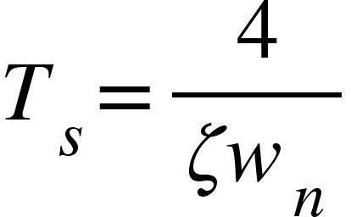
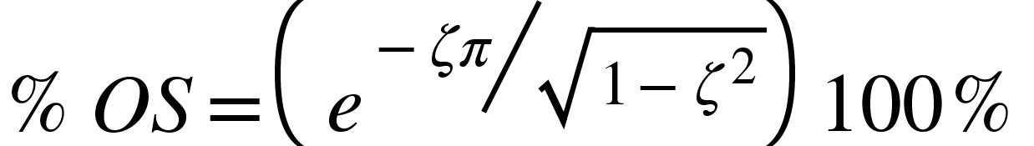
Root Locus
%OS = 5%
Ts= 4 sec
Damping ratio=0.7
Wn = 1.45

Slide 5
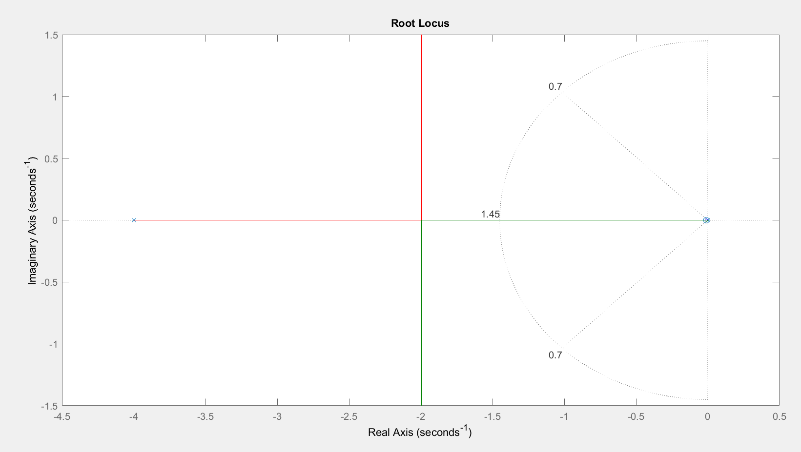
Lead Controller
Poles:
0.01
4

Slide 6
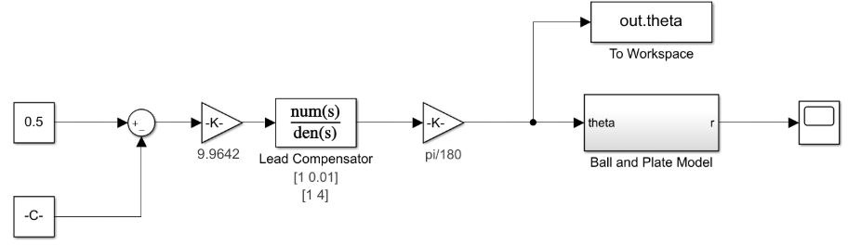
Simulink Model Used Before Coppelia
Notes:
This is the entire simulink model we used before we linked it to Coppelia. The first block is the initial value of the ball, the block below it is the current value of the ball. The next 2 block, which have already been discussed are the gain and the lead compensator. The second k converts the lead compensator’s output of degrees to radians. This angle is then output to the workspace & the theoretical ball and plate model.Finally, it outputs a waveform chart, plotting the position of the ball. If everything works the waveform should stabilize at 0.5

Slide 7
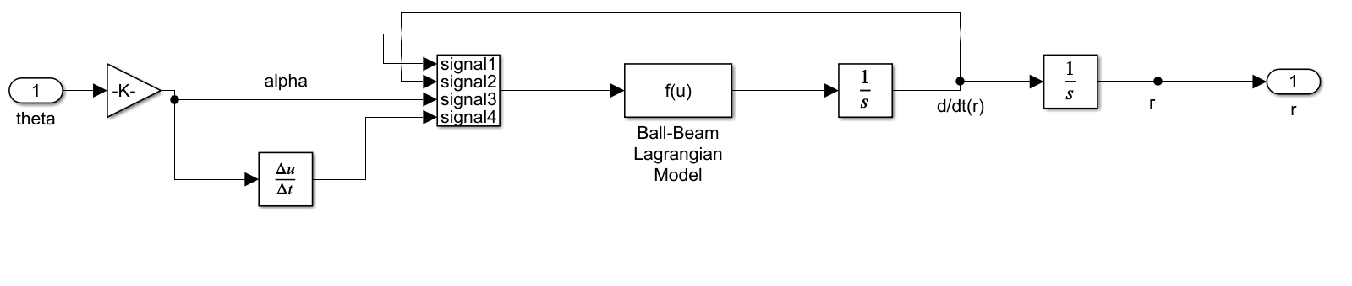
Ball and Beam Simulink Model
Notes:
This is the structure of the theoretical ball and plate model used before we linked it to coppelia. Our approach to simulating a ball and plate was to take a simpler model, a ball and BEAM and then use the model twice, the first model will simulate the x-axis and the second model will simulate the y-axis.
By running both models concurrently we can effectively model a ball and plate.

Slide 8
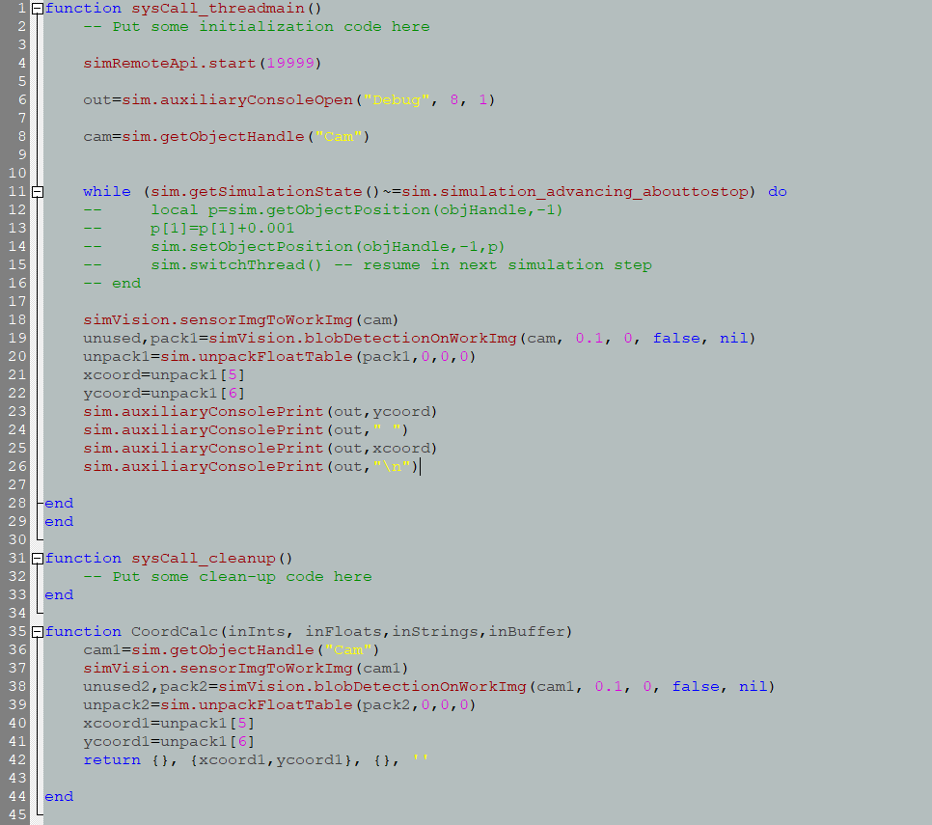
Coppelia’s Code to Communicate with Matlab

Slide 9
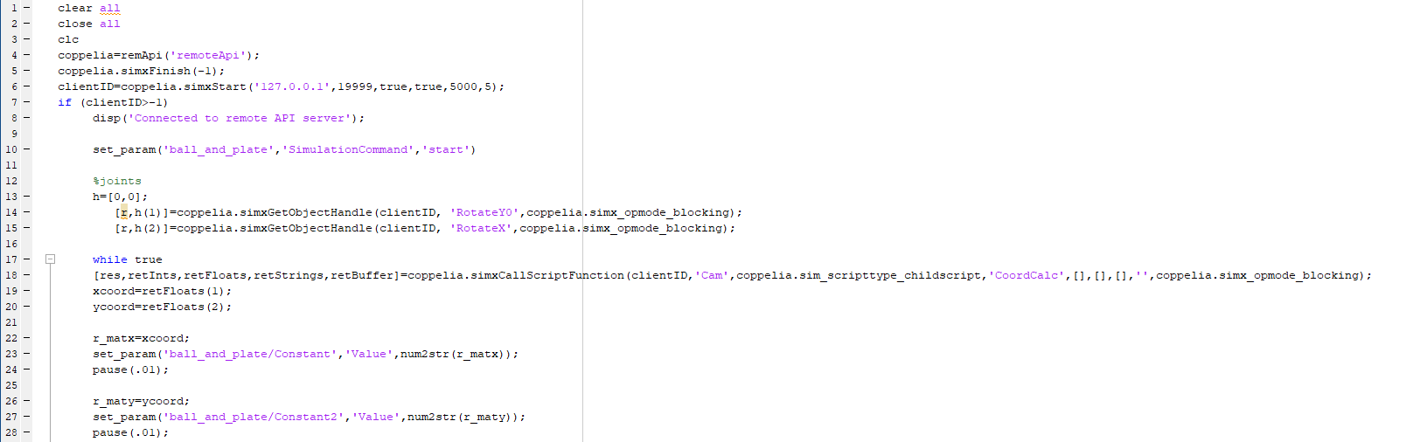
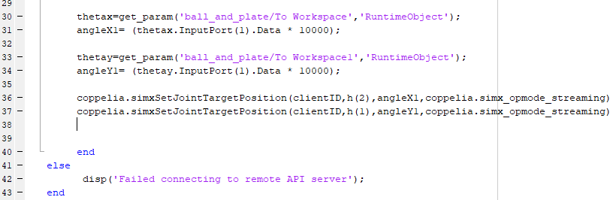
Matlab Code to Communicate with Coppelia

Slide 10
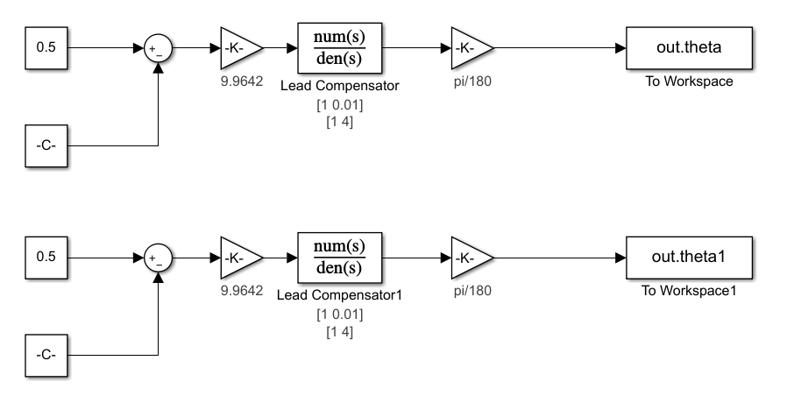
Simulink Model Used With Coppelia
Notes:
The Final simulink model incorporates 2 instances of the ball and beam model, simulating the 2-dimensions of the ball-and-plate model. In this model, the first line calculates the placement along the x-axis while the second line calculates for the y-axis. The targeted values are once again 0.5 for both the x and y axies, with C representing the current x/y positions of the ball imported from Coppelia. The difference of these two values is then calculated to find the needed correction to return the ball to the center position. This value is then passed through the gain and lead compensator, then converted from degrees to radians, and then output to Matlab. Matlab then outputs this radian angle to Coppelia through the “SetJointPosition” function, adjusting the motor’s positions to that radian value.

Slide 11

Coppelia Simulation Using Simulink and Matlab
Notes:
Here in the simulation, we can see this process at work. The x and y placement values are seen in the dialogue box, being processed in real time. This is the value being given to Simulink/Matlab as described in the previous slide. The outcome of Simulink/Matlab’s calculations gives the motor position to Coppelia, which as seen here, begins to return the ball to its centered position. However, this video fails to show the time needed to calibrate within Coppelia the processing speed. Issues occurred with calculating the velocity of the ball at any given moment, causing over corrections to occur. This was solved by slowing Coppelia’s processing speed.

